Slide 1
Fire Department Calls for Service Analytics - Key Insights
Fire Calls by Response Time (In mins): Around 73% calls were responded within 4 mins. (49% calls & 24% calls were responded within 2-4 mins & 0-2 mins respectively)
Fire Calls received by Call types: Around 65%, 12% and 11% calls were from Medical Incident, Structure Fire, Alarms respectively.
Fire Calls received by Call types Group: Observed relatively high-volume calls were from Potentially Life-Threatening Group
Fire Calls received by Call Final Disposition: Significant volume of calls were from Code 2 Transport and Fire group.
Medical Incident Call: Almost 60% of the calls were responded within 6 mins for Medical Incident Call type.
Average Response Time by Call Type: The Alarms, Lightening Strikes Calls have avg. response time within 5 mins, but seen more than 5 mins avg. response time for Train Incident, Admin, Mutual Aid / Asst Outside Agency categories.
Fire Calls received by year: Seen more fire incident calls after 2015 onwards (last 6 years)
Fire Calls received by hours: Peak Call hours are seen between 11 am to 5 pm while seen more calls between 8 am to 8 pm.
High Calls by ZIP/ Stations: We are seeing more calls from 94108, 94116, 94123 zip codes & from 47, 04, 27 stations

Slide 2
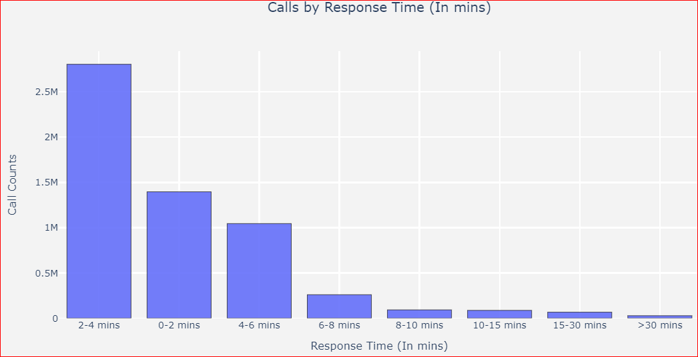
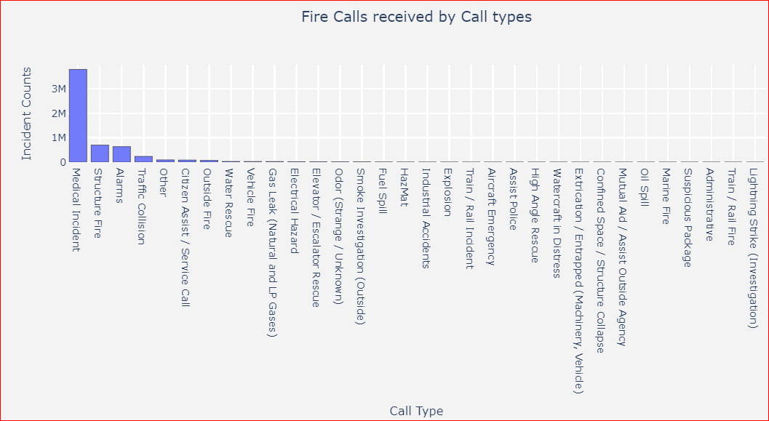
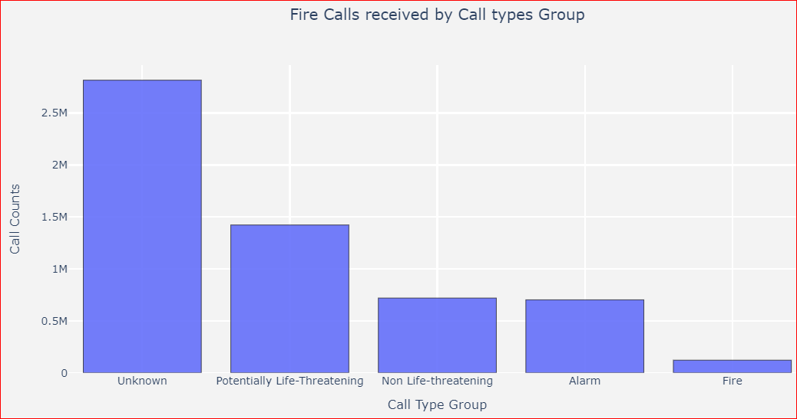
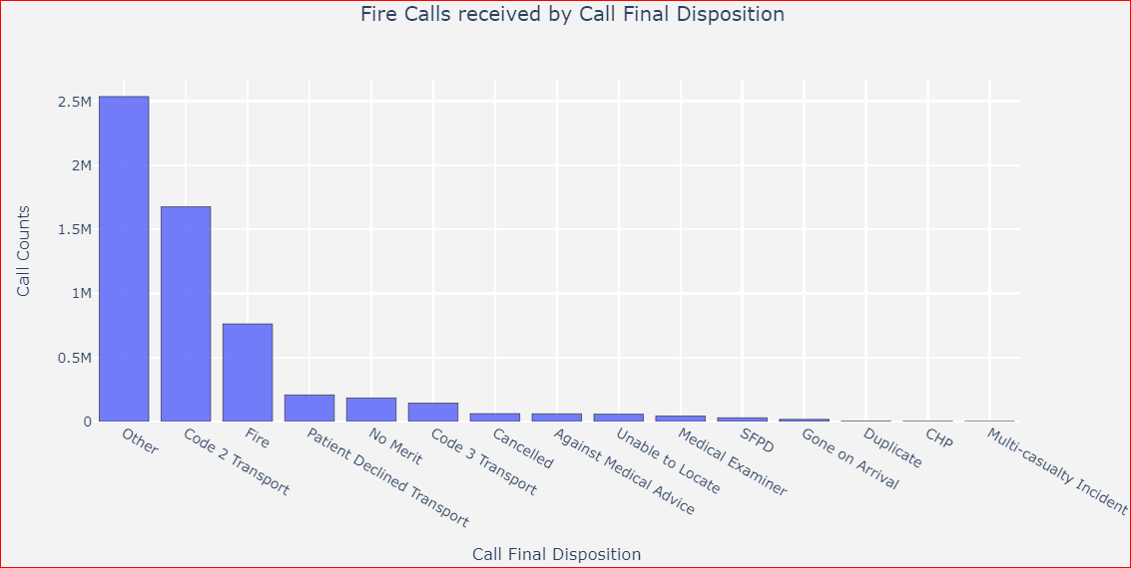
Exploratory Data Analysis-1

Slide 3
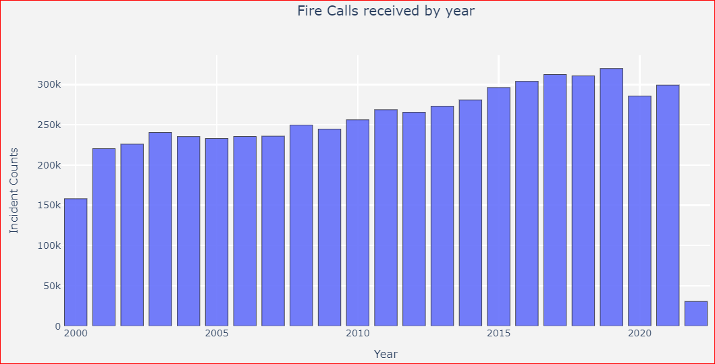
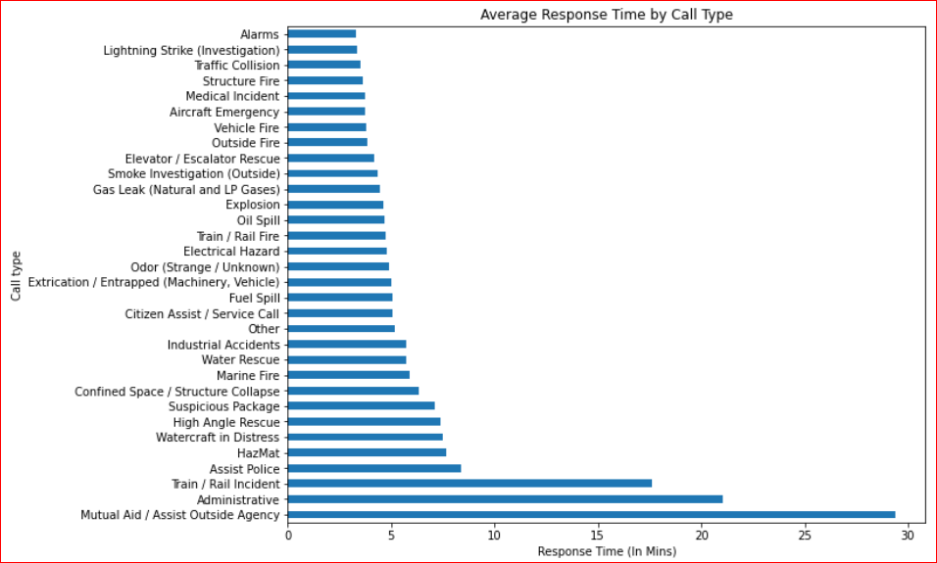
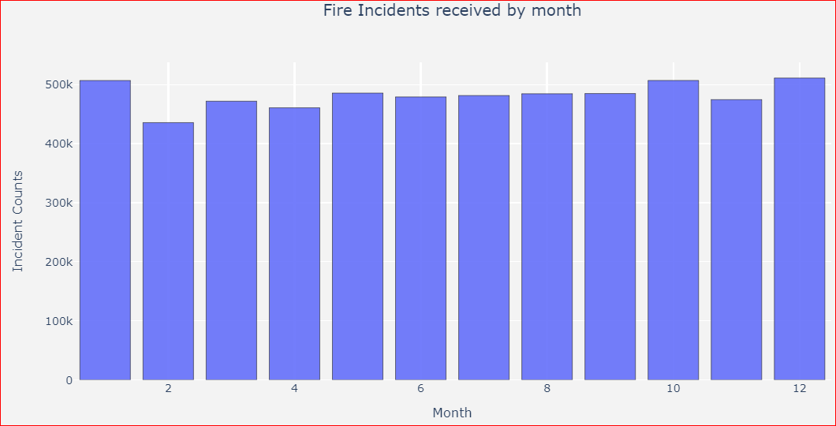
Exploratory Data Analysis-2

Slide 4
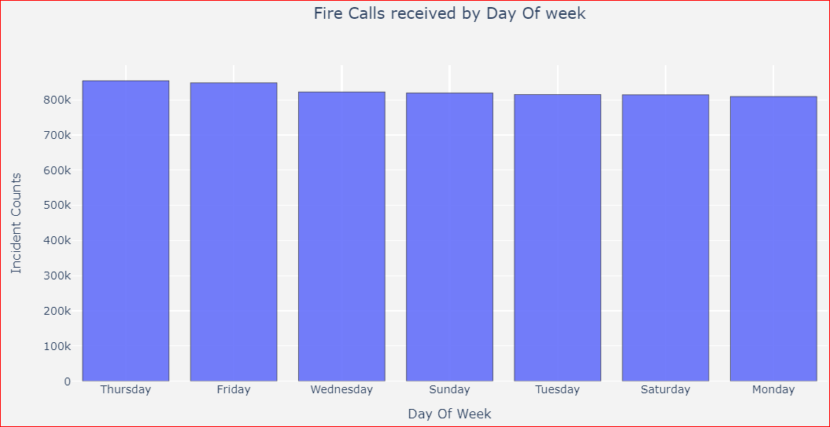
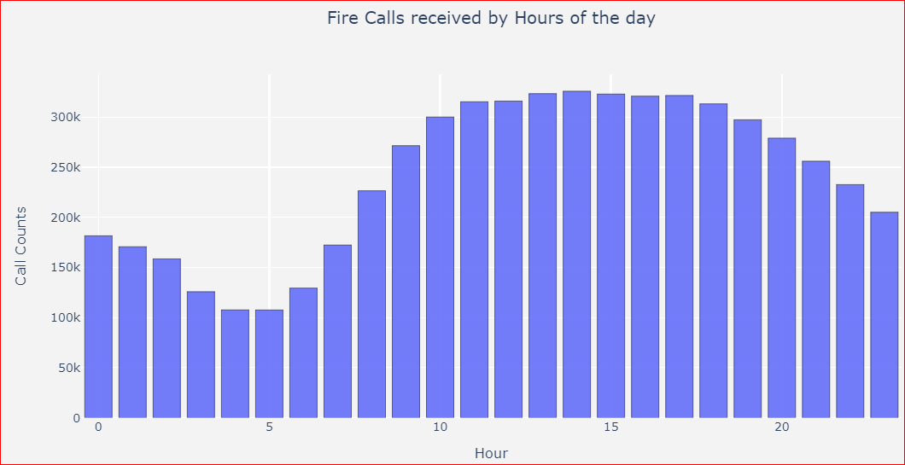
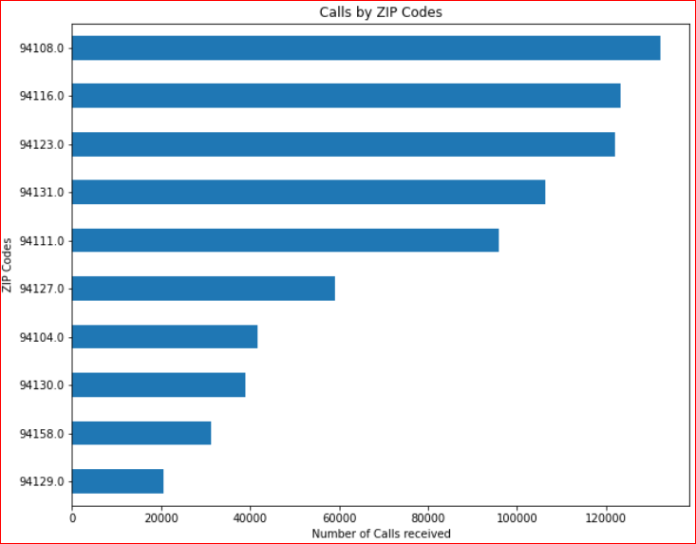
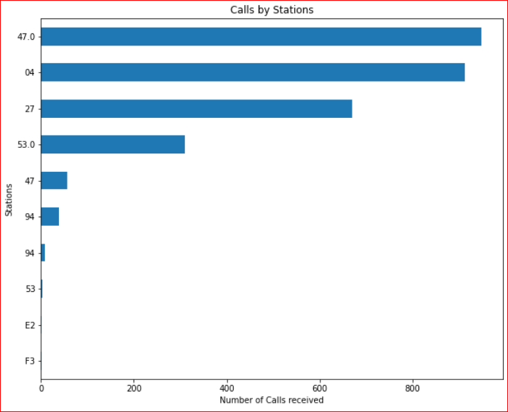
Exploratory Data Analysis-3

Slide 5
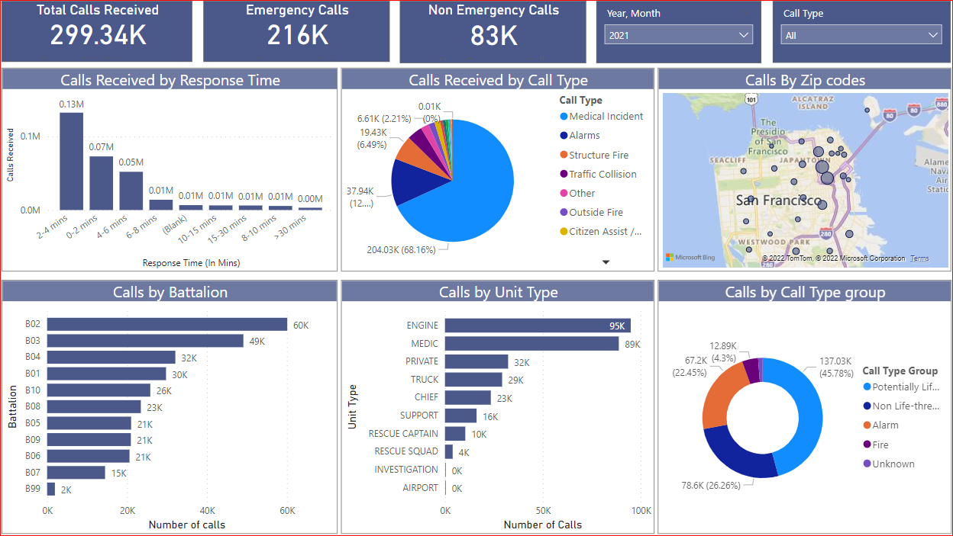
Power BI Visualization
GitHub: https://nbviewer.org/github/pramodcgupta/MMC_Usecases/blob/main/Fire_Dept_Calls_Analytics.ipynb

